Slide 1

Searching AND INDEXING Big data
-By Jagadish Rouniyar

Slide 2
What is it?
Doug Cutting’s grandmother’s middle name
A open source set of Java Classses
Search Engine/Document Classifier/Indexer
http://lucene.sourceforge.net/talks/pisa/
Developed by Doug Cutting 1996
Xerox/Apple/Excite/Nutch
Wrote several papers in IR

Slide 3
Lucene
Open source Java library for indexing and searching
Lets you add search to your application
High performance, scalable, full-text search library
Not a complete search system by itself
Written by Doug Cutting
Used by LinkedIn, Twitter, …
…and many more (see http://wiki.apache.org/lucene-java/PoweredBy)
Ports/integrations to other languages
C/C++, C#, Ruby, Perl, Python, PHP, …

Slide 4
Resources
Lucene: http://lucene.apache.org/core/
Lucene in Action: http://www.manning.com/hatcher3/
Code samples available for download
Ant: http://ant.apache.org/
Java build system used by “Lucene in Action” code

Slide 5
Lucene in a search system
Users
Index document
Analyze document
Search
Index
Build document
Build query
Render results
Acquire content
Raw Content
Run query

Slide 6
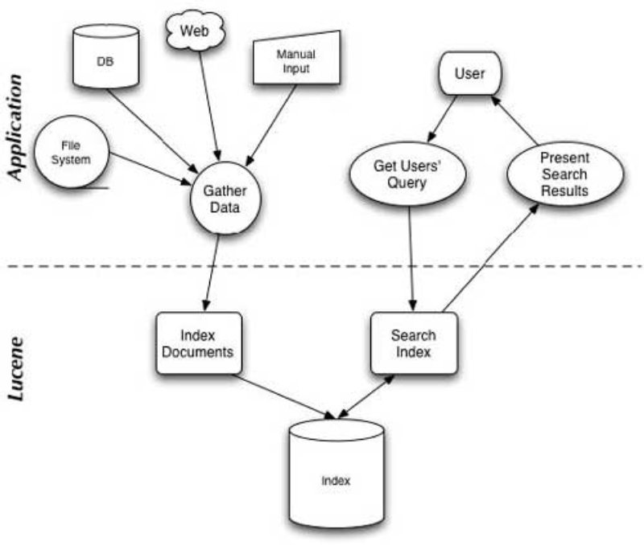
Lucene iMPLEMENTATION

Slide 7
Lucene Index: Concepts
The theory
Concepts
Index: sequence of documents (a.k.a. Directory)
Document: sequence of fields
Field: named sequence of terms
Term: a text string (e.g., a word)
Statistics
Term frequencies and positions

Slide 8
Core indexing classes
IndexWriter
Central component that allows you to create a new index, open an existing one, and add, remove, or update documents in an index
Directory
Abstract class that represents the location of an index
Analyzer
Extracts tokens from a text stream

Slide 9
Lucene Implementation

Slide 10
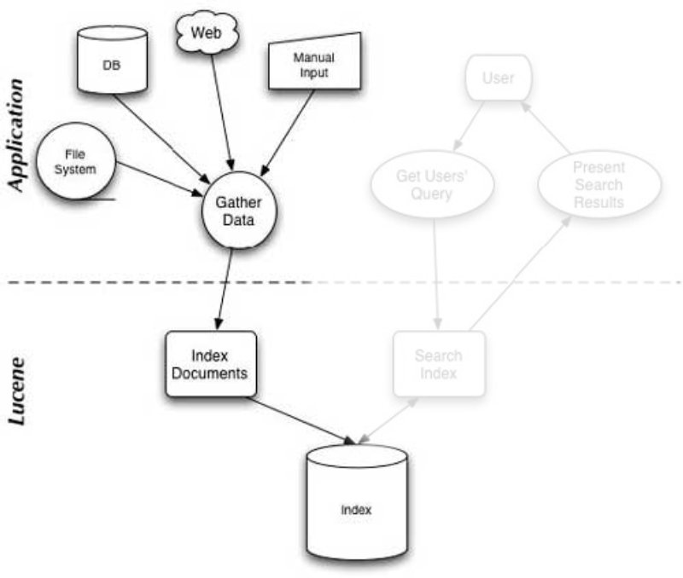
Lucene Implementation: Indexing

Slide 11
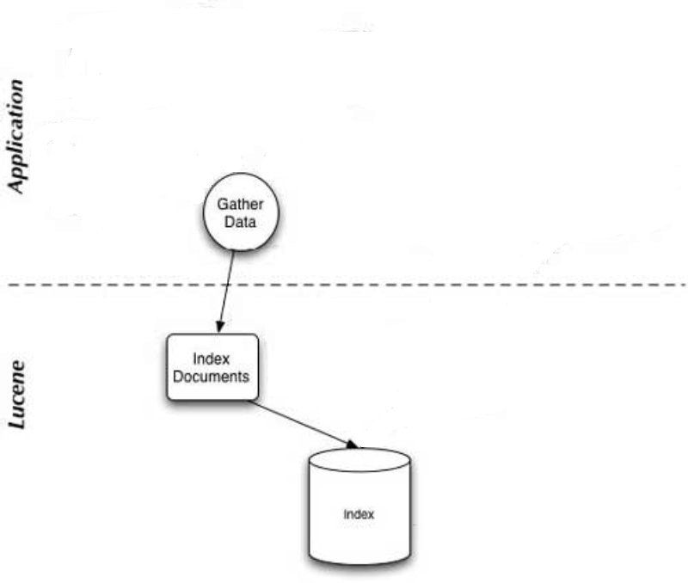
Lucene Implementation: Indexing

Slide 12
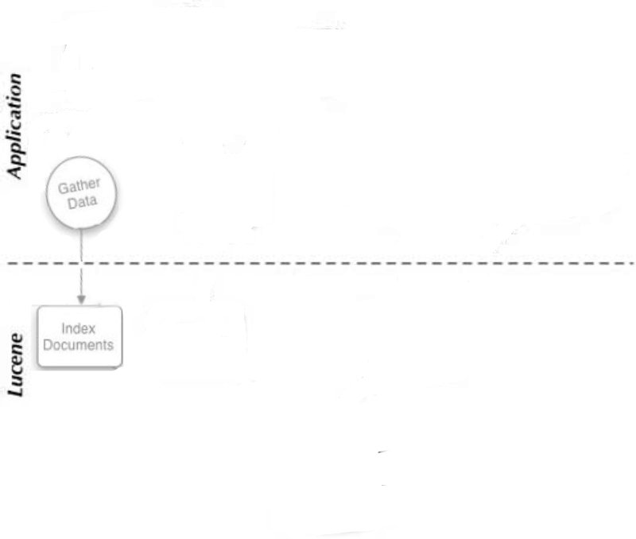
Lucene Implementation: Indexing

Slide 13
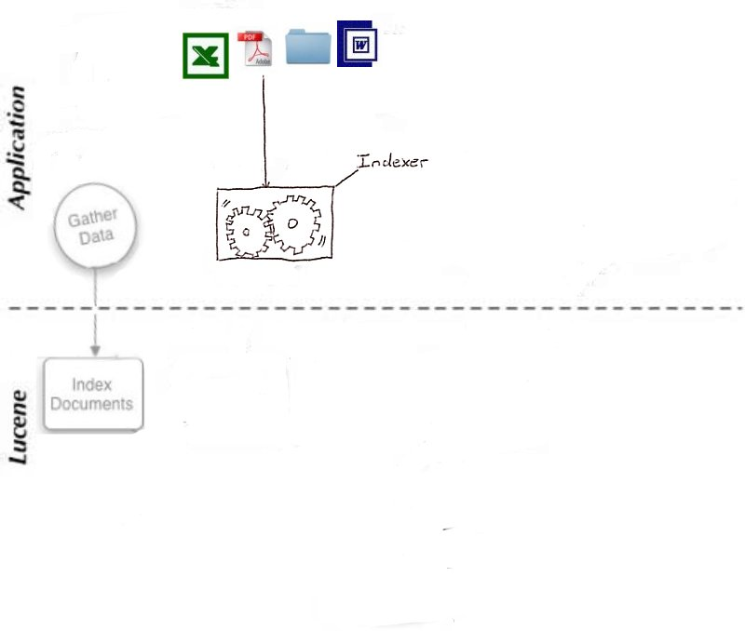
Lucene Indexing

Slide 14
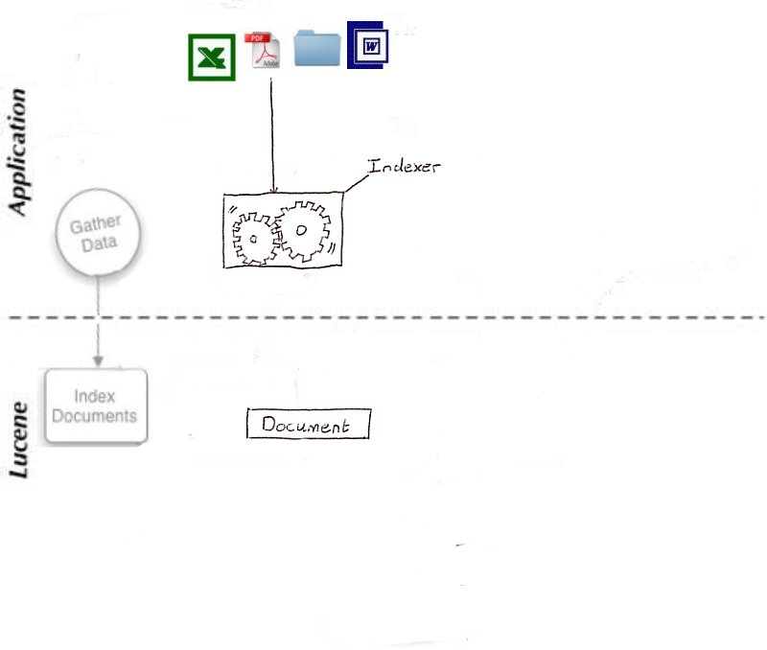
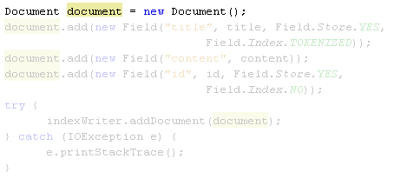
Lucene Indexing Step 1 of 5

Slide 15
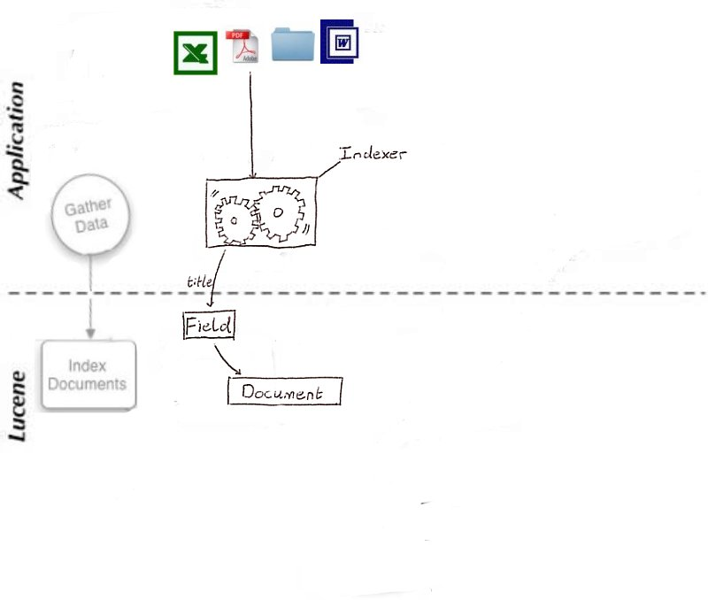
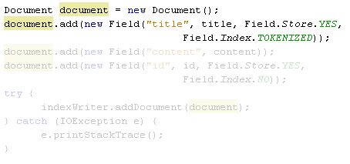
Lucene Indexing Step 2 of 5

Slide 16
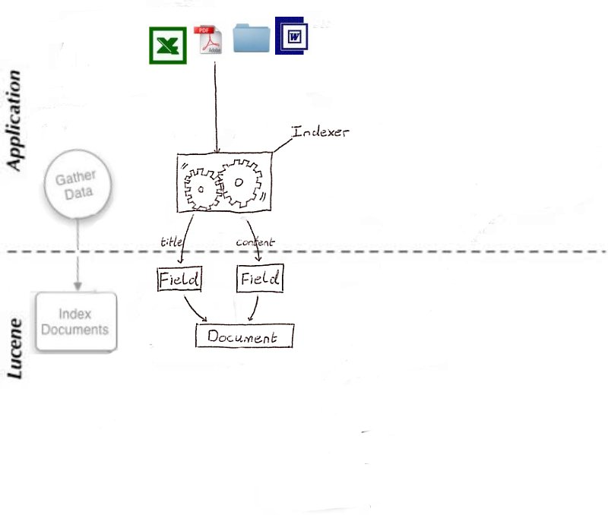
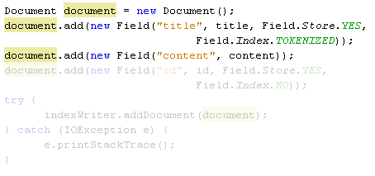
Lucene Indexing Step 3 of 5

Slide 17
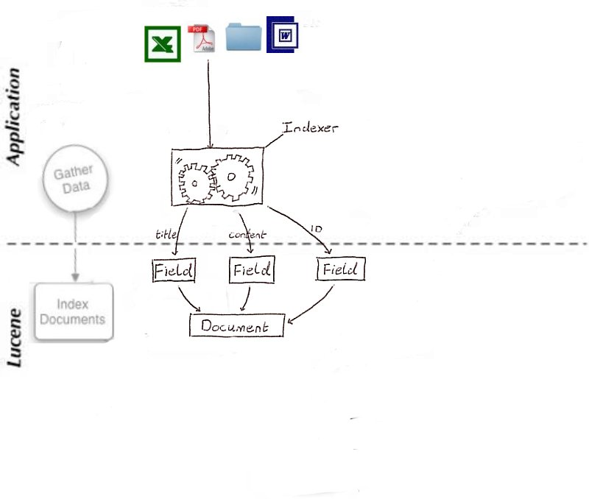
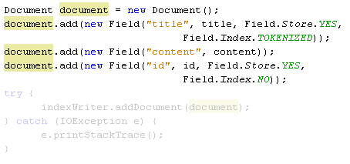
Lucene Indexing Step 4 of 5

Slide 18
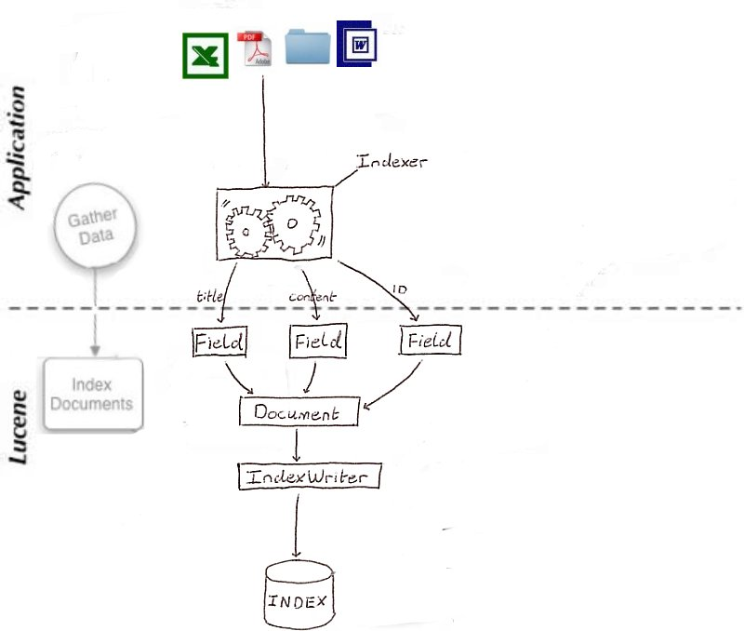
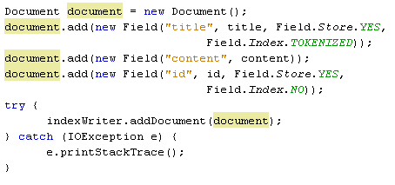
Lucene Indexing Step 5 of 5

Slide 19
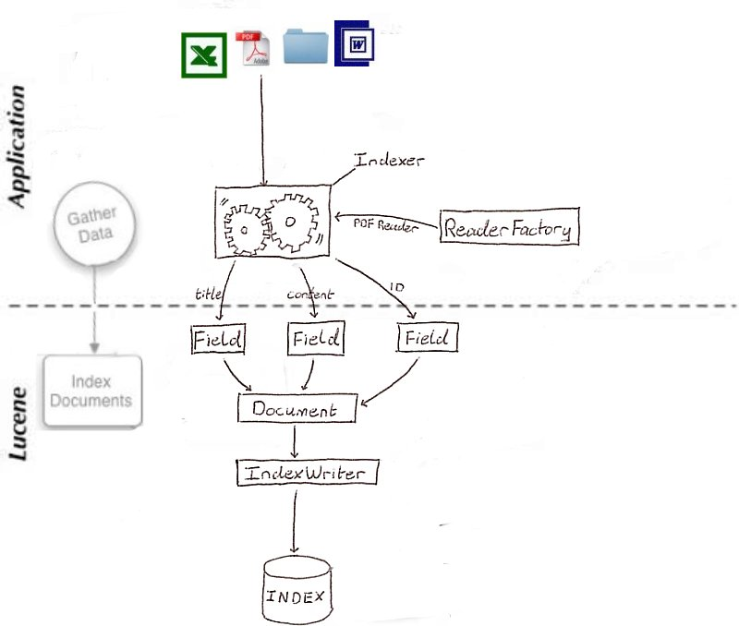
Lucene Indexing

Slide 20
Lucene Implementation

Slide 21
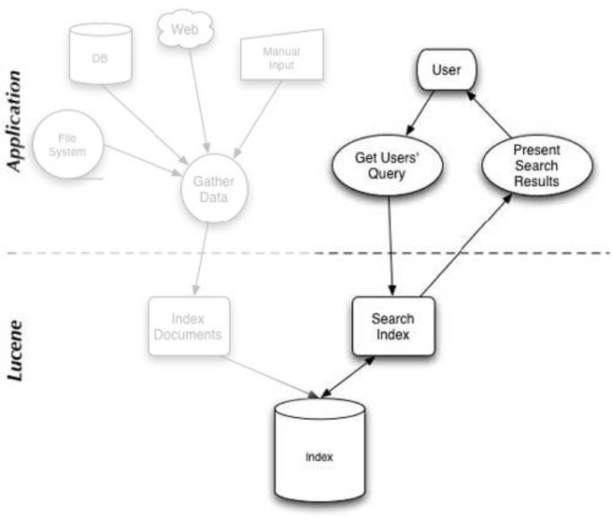
Lucene Implementation

Slide 22
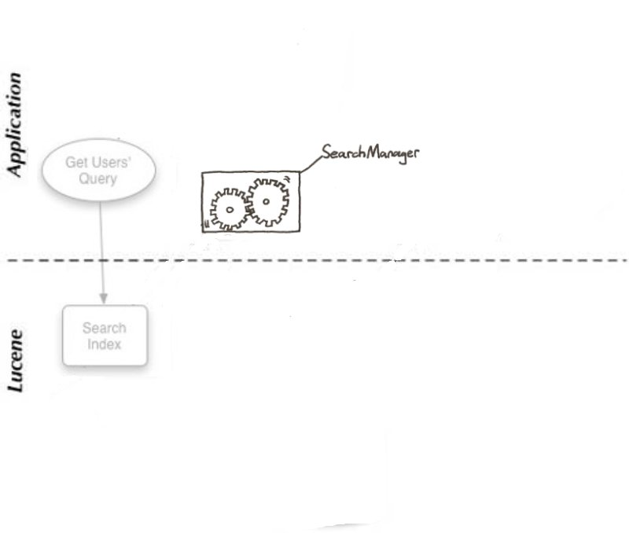
Searching:

Slide 23
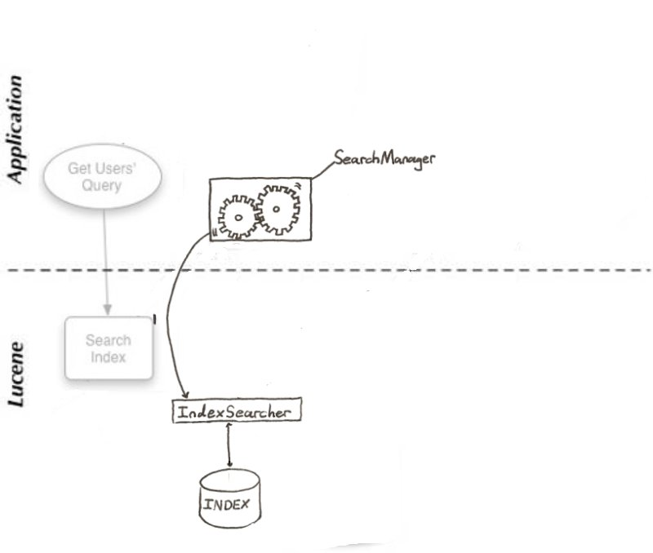
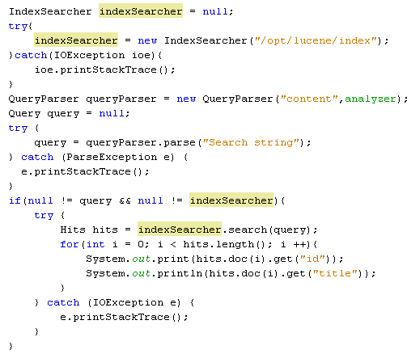

Searching: Step 1 of 6

Slide 24
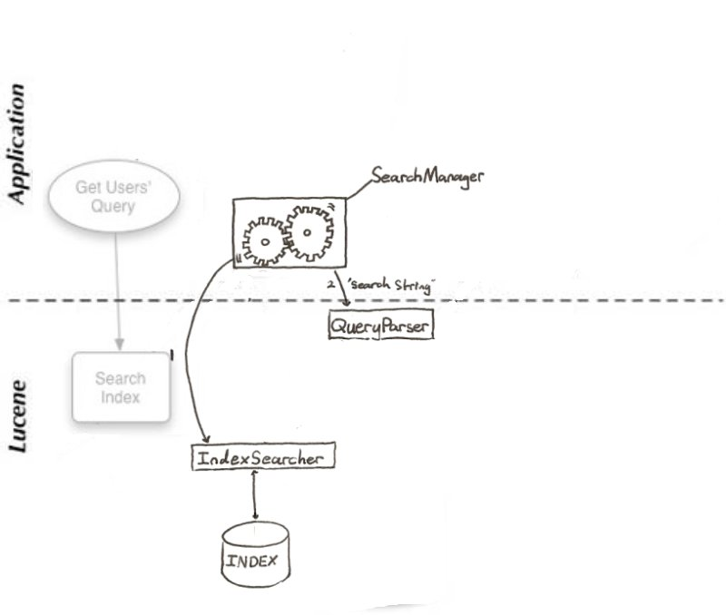

Searching: Step 2 of 6

Slide 25
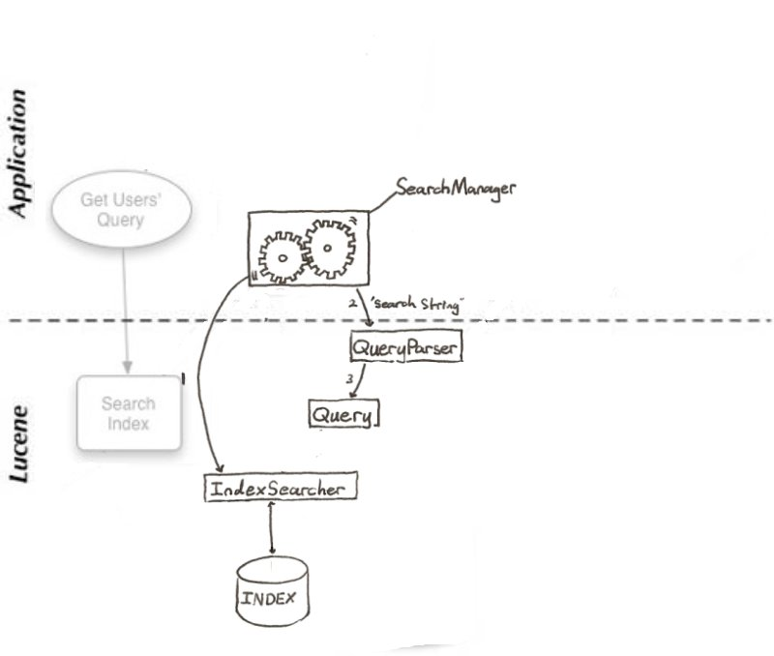
Searching: Step 3 of 6

Slide 26
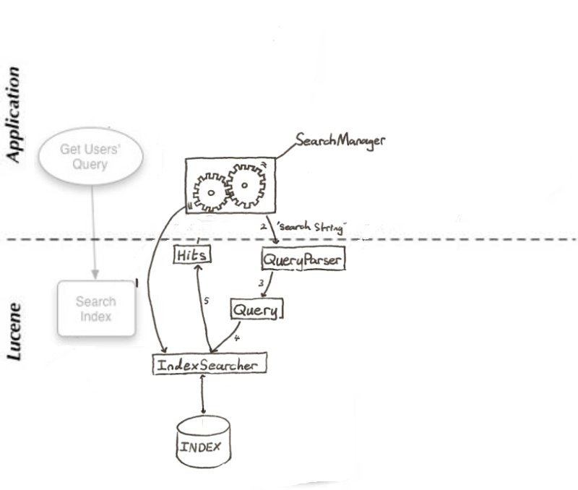
Searching: Step 4&5 of 6

Slide 27

Searching: Step 6 of 6

Slide 28
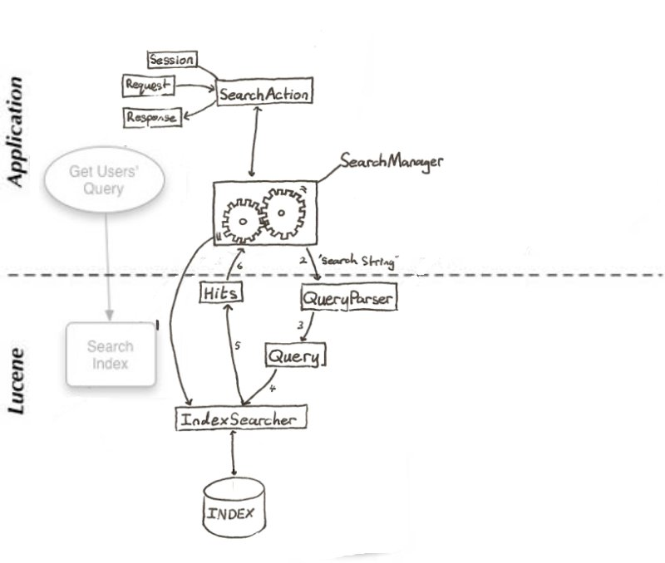
Searching:

Slide 29
Creating an IndexWriter
import org.apache.lucene.index.IndexWriter;
import org.apache.lucene.store.Directory;
import org.apache.lucene.analysis.standard.StandardAnalyzer; ...
private IndexWriter writer;
...
public Indexer(String indexDir) throws IOException {
Directory dir = FSDirectory.open(new File(indexDir));
writer = new IndexWriter(
dir,
new StandardAnalyzer(Version.LUCENE_30),
true,
IndexWriter.MaxFieldLength.UNLIMITED);
}

Slide 30
Core indexing classes (contd.)
Document
Represents a collection of named Fields. Text in these Fields are indexed.
Field
Note: Lucene Fields can represent both “fields” and “zones”

Slide 31
Lucene’s data structures
Inverted
Index
Store
search
Hits
retrieve
stored fields
Results

Slide 32
Store
Documents:
Store
Field 1: title
Field 2: content
Field 3: hashvalue
D0
F1
F2
F3
D1
F1
F2
F3
D2
F1
F2
F3

Slide 33
A Document contains Fields
import org.apache.lucene.document.Document;
import org.apache.lucene.document.Field;
...
protected Document getDocument(File f) throws Exception {
Document doc = new Document();
doc.add(new Field("contents”, new FileReader(f)))
doc.add(new Field("filename”, f.getName(),
Field.Store.YES, Field.Index.NOT_ANALYZED));
doc.add(new Field("fullpath”,
f.getCanonicalPath(),
Field.Store.YES,
Field.Index.NOT_ANALYZED));
return doc;
}

Slide 34
Index a Document with IndexWriter
private IndexWriter writer;
...
private void indexFile(File f) throws
Exception {
Document doc = getDocument(f);
writer.addDocument(doc);
}

Slide 35
Indexing a directory
private IndexWriter writer;
...
public int index(String dataDir,
FileFilter filter)
throws Exception {
File[] files = new File(dataDir).listFiles();
for (File f: files) {
if (... &&
(filter == null || filter.accept(f))) {
indexFile(f);
}
}
return writer.numDocs();
}

Slide 36
Closing the IndexWriter
private IndexWriter writer;
...
public void close() throws IOException {
writer.close();
}

Slide 37
Indexing
Attributes
Stored: original content retrievable
Indexed: inverted, searchable
Tokenized: analyzed, split into tokens
Factory methods
Keyword: stored and indexed as single term
Text: indexed, tokenized, and stored if String
UnIndexed: stored
UnStored: indexed, tokenized
Terms are what matter for searching

Slide 38
Core searching classes
IndexSearcher
Central class that exposes several search methods on an index
Query
Abstract query class. Concrete subclasses represent specific types of queries, e.g., matching terms in fields, boolean queries, phrase queries, …
QueryParser
Parses a textual representation of a query into a Query instance

Slide 39
Creating an IndexSearcher
import org.apache.lucene.search.IndexSearcher;
...
public static void search(String indexDir,
String q)
throws IOException, ParseException {
Directory dir = FSDirectory.open(
new File(indexDir));
IndexSearcher is = new IndexSearcher(dir);
...
}

Slide 40
Query and QueryParser
import org.apache.lucene.search.Query;
import org.apache.lucene.queryParser.QueryParser;
...
public static void search(String indexDir, String q)
throws IOException, ParseException
...
QueryParser parser =
new QueryParser(Version.LUCENE_30,
"contents”,
new StandardAnalyzer(
Version.LUCENE_30));
Query query = parser.parse(q);
...
}

Slide 41
Core searching classes (contd.)
TopDocs
Contains references to the top documents returned by a search
ScoreDoc
Represents a single search result

Slide 42
search() returns TopDocs
import org.apache.lucene.search.TopDocs;
...
public static void search(String indexDir,
String q)
throws IOException, ParseException
...
IndexSearcher is = ...;
...
Query query = ...;
...
TopDocs hits = is.search(query, 10);
}

Slide 43
TopDocs contain ScoreDocs
import org.apache.lucene.search.ScoreDoc;
...
public static void search(String indexDir, String q)
throws IOException, ParseException
...
IndexSearcher is = ...;
...
TopDocs hits = ...;
...
for(ScoreDoc scoreDoc : hits.scoreDocs) {
Document doc = is.doc(scoreDoc.doc);
System.out.println(doc.get("fullpath"));
}
}

Slide 44
Closing IndexSearcher
public static void search(String indexDir,
String q)
throws IOException, ParseException
...
IndexSearcher is = ...;
...
is.close();
}

Slide 45
Lucene Code Example: Indexing
01 Analyzer analyzer = new StandardAnalyzer(); 02 IndexWriter iw = new IndexWriter("/tmp/testindex", analyzer, true); 03 04 Document doc = new Document(); 05 doc.add(new Field("body", "This is my TEST document", 06 Field.Store.YES, Field.Index.TOKENIZED)); 07 iw.addDocument(doc); 08 09 iw.optimize(); 10 iw.close();
loop
StandardAnalyzer: my, test, document

Slide 46
Lucene Code Example: Searching
01 Analyzer analyzer = new StandardAnalyzer(); 02 IndexSearcher is = new IndexSearcher("/tmp/testindex"); 03 04 QueryParser qp = new QueryParser("body", analyzer); 05 String userInput = "document AND test"; 06 Query q = qp.parse(userInput); 07 Hits hits = is.search(q); 08 for (Iterator iter = hits.iterator(); iter.hasNext();) { 09 Hit hit = (Hit) iter.next(); 10 System.out.println(hit.getScore() + " " + hit.get("body")); 11 } 12 13 is.close();

Slide 47
How Lucene models content
A Document is the atomic unit of indexing and searching
A Document contains Fields
Fields have a name and a value
You have to translate raw content into Fields
Examples: Title, author, date, abstract, body, URL, keywords, ...
Different documents can have different fields
Search a field using name:term, e.g., title:lucene

Slide 48
Fields
Fields may
Be indexed or not
Indexed fields may or may not be analyzed (i.e., tokenized with an Analyzer)
Non-analyzed fields view the entire value as a single token (useful for URLs, paths, dates, social security numbers, ...)
Be stored or not
Useful for fields that you’d like to display to users
Optionally store term vectors
Like a positional index on the Field’s terms
Useful for highlighting, finding similar documents, categorization

Slide 49
Field construction Lots of different constructors
import org.apache.lucene.document.Field
Field(String name,
String value,
Field.Store store, // store or not
Field.Index index, // index or not
Field.TermVector termVector);
value can also be specified with a Reader, a TokenStream, or a byte[]

Slide 50
Field options
Field.Store
NO : Don’t store the field value in the index
YES : Store the field value in the index
Field.Index
ANALYZED : Tokenize with an Analyzer
NOT_ANALYZED : Do not tokenize
NO : Do not index this field
Couple of other advanced options
Field.TermVector
NO : Don’t store term vectors
YES : Store term vectors
Several other options to store positions and offsets

Slide 51
Using Field options
Index | Store | TermVector | Example usage
NOT_ANALYZED | YES | NO | Identifiers, telephone/SSNs, URLs, dates, ...
ANALYZED | YES | WITH_POSITIONS_OFFSETS | Title, abstract
ANALYZED | NO | WITH_POSITIONS_OFFSETS | Body
NO | YES | NO | Document type, DB keys (if not used for searching)
NOT_ANALYZED | NO | NO | Hidden keywords

Slide 52
Document
import org.apache.lucene.document.Field
Constructor:
Document();
Methods
void add(Fieldable field); // Field implements // Fieldable
String get(String name); // Returns value of // Field with given // name
Fieldable getFieldable(String name);
... and many more

Slide 53
Multi-valued fields
You can add multiple Fields with the same name
Lucene simply concatenates the different values for that named Field
Document doc = new Document();
doc.add(new Field(“author”,
“chris manning”,
Field.Store.YES,
Field.Index.ANALYZED));
doc.add(new Field(“author”,
“prabhakar raghavan”,
Field.Store.YES,
Field.Index.ANALYZED));
...

Slide 54
Analyzers
Tokenizes the input text
Common Analyzers
WhitespaceAnalyzer Splits tokens on whitespace
SimpleAnalyzer Splits tokens on non-letters, and then lowercases
StopAnalyzer Same as SimpleAnalyzer, but also removes stop words
StandardAnalyzer Most sophisticated analyzer that knows about certain token types, lowercases, removes stop words, ...

Slide 55
Analysis examples
“The quick brown fox jumped over the lazy dog”
WhitespaceAnalyzer
[The] [quick] [brown] [fox] [jumped] [over] [the] [lazy] [dog]
SimpleAnalyzer
[the] [quick] [brown] [fox] [jumped] [over] [the] [lazy] [dog]
StopAnalyzer
[quick] [brown] [fox] [jumped] [over] [lazy] [dog]
StandardAnalyzer
[quick] [brown] [fox] [jumped] [over] [lazy] [dog]

Slide 56
More analysis examples
“XY&Z Corporation – xyz@example.com”
WhitespaceAnalyzer
[XY&Z] [Corporation] [-] [xyz@example.com]
SimpleAnalyzer
[xy] [z] [corporation] [xyz] [example] [com]
StopAnalyzer
[xy] [z] [corporation] [xyz] [example] [com]
StandardAnalyzer
[xy&z] [corporation] [xyz@example.com]

Slide 57
What’s inside an Analyzer?
Analyzers need to return a TokenStream public TokenStream tokenStream(String fieldName, Reader reader)
TokenStream
Tokenizer
TokenFilter
Reader
Tokenizer
TokenFilter
TokenFilter

Slide 58
Tokenizers and TokenFilters
Tokenizer
WhitespaceTokenizer
KeywordTokenizer
LetterTokenizer
StandardTokenizer
...
TokenFilter
LowerCaseFilter
StopFilter
PorterStemFilter
ASCIIFoldingFilter
StandardFilter
...

Slide 59
IndexWriter construction
// Deprecated
IndexWriter(Directory d,
Analyzer a, // default analyzer
IndexWriter.MaxFieldLength mfl);
// Preferred
IndexWriter(Directory d,
IndexWriterConfig c);

Slide 60
Adding/deleting Documents to/from an IndexWriter
void addDocument(Document d);
void addDocument(Document d, Analyzer a);
Important: Need to ensure that Analyzers used at indexing time are consistent with Analyzers used at searching time
// deletes docs containing term or matching
// query. The term version is useful for
// deleting one document.
void deleteDocuments(Term term);
void deleteDocuments(Query query);

Slide 61
Index format
Each Lucene index consists of one or more segments
A segment is a standalone index for a subset of documents
All segments are searched
A segment is created whenever IndexWriter flushes adds/deletes
Periodically, IndexWriter will merge a set of segments into a single segment
Policy specified by a MergePolicy
You can explicitly invoke optimize() to merge segments

Slide 62
Basic merge policy
Segments are grouped into levels
Segments within a group are roughly equal size (in log space)
Once a level has enough segments, they are merged into a segment at the next level up

Slide 63
IndexSearcher
Constructor:
IndexSearcher(Directory d);
deprecated

Slide 64
IndexReader
Query
IndexSearcher
TopDocs
IndexReader
Directory

Slide 65
IndexSearcher
Constructor:
IndexSearcher(Directory d);
deprecated
IndexSearcher(IndexReader r);
Construct an IndexReader with static method IndexReader.open(dir)

Slide 66
Searching a changing index
Directory dir = FSDirectory.open(...);
IndexReader reader = IndexReader.open(dir);
IndexSearcher searcher = new IndexSearcher(reader);
Above reader does not reflect changes to the index unless you reopen it.
Reopening is more resource efficient than opening a new IndexReader.
IndexReader newReader = reader.reopen();
If (reader != newReader) {
reader.close();
reader = newReader;
searcher = new IndexSearcher(reader);
}

Slide 67
Near-real-time search
IndexWriter writer = ...;
IndexReader reader = writer.getReader();
IndexSearcher searcher = new IndexSearcher(reader);
Now let us say there’s a change to the index using writer
// reopen() and getReader() force writer to flush
IndexReader newReader = reader.reopen();
if (reader != newReader) {
reader.close();
reader = newReader;
searcher = new IndexSearcher(reader);
}

Slide 68
IndexSearcher
Methods
TopDocs search(Query q, int n);
Document doc(int docID);

Slide 69
QueryParser
Constructor
QueryParser(Version matchVersion, String defaultField, Analyzer analyzer);
Parsing methods
Query parse(String query) throws ParseException;
... and many more

Slide 70
QueryParser syntax examples
Query expression | Document matches if…
java | Contains the term java in the default field
java junit java OR junit | Contains the term java or junit or both in the default field (the default operator can be changed to AND)
+java +junit java AND junit | Contains both java and junit in the default field
title:ant | Contains the term ant in the title field
title:extreme –subject:sports | Contains extreme in the title and not sports in subject
(agile OR extreme) AND java | Boolean expression matches
title:”junit in action” | Phrase matches in title
title:”junit action”~5 | Proximity matches (within 5) in title
java* | Wildcard matches
java~ | Fuzzy matches
lastmodified:[1/1/09 TO 12/31/09] | Range matches

Slide 71
Construct Querys programmatically
TermQuery
Constructed from a Term
TermRangeQuery
NumericRangeQuery
PrefixQuery
BooleanQuery
PhraseQuery
WildcardQuery
FuzzyQuery
MatchAllDocsQuery

Slide 72
TopDocs and ScoreDoc
TopDocs methods
Number of documents that matched the search totalHits
Array of ScoreDoc instances containing results scoreDocs
Returns best score of all matches getMaxScore()
ScoreDoc methods
Document id doc
Document score score

Slide 73
Scoring
Scoring function uses
Programmable boost values for certain fields in documents
Length normalization
Boosts for documents containing more of the query terms
IndexSearcher provides an explain() method that explains the scoring of a document

Slide 74

Search and Analytics (using Elasticsearch)
Search – what’s the big deal?
Basic/Metadata retrieval
“Find banks with more then (x) accounts”
“Find banks near my location”

Slide 75
Search categories
Basic/Metadata retrieval : data stores
search engines:
Full-text search
Highlighting
Geolocation
Fuzzy search (“did-you-mean”)
Natural Language

Slide 76
Elasticsearch
ElasticSearch is a Distributed, RESTful, free/open source search server based on Apache Lucene. It is developed by Shay Banon^{[1]} and is released under the terms of the Apache License. ElasticSearch is developed in Java.
Open-Source Search & Analytics engine
Structured & Unstructured Data
Real Time
Analytics capabilities (facets)
REST based
Distributed
Designed for the Cloud
Designed for Big Data

Slide 77
Elasticsearch
Advantages:
ElasticSearch is distributed.
ElasticSearch fully supports the near real-time search of Apache Lucene.
Handling multitenancy is not a special configuration, whereas a more advanced setup is necessary with Solr.
ElasticSearch introduces the concept of the Gateway, which makes full backups easier.
Disadvantages:
Vendor dependent

Slide 78
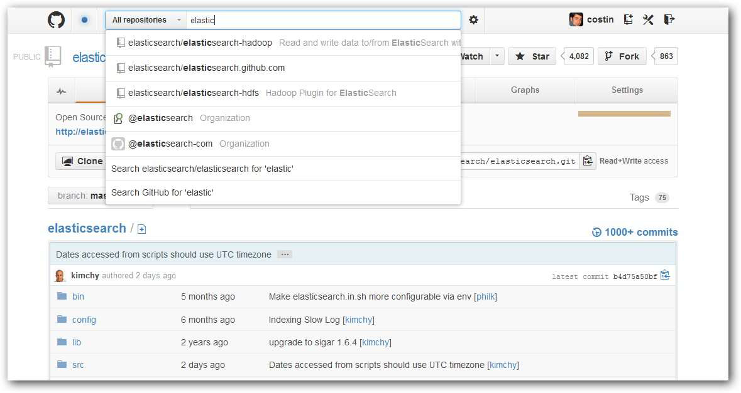
Use Case - Text Search

Slide 79
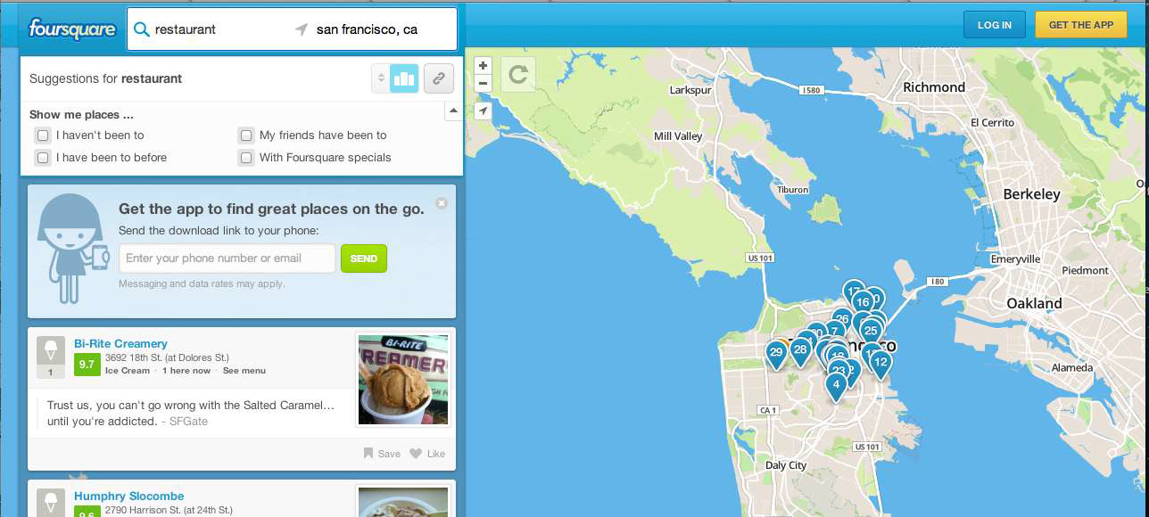
Use Case - Geolocation
Searches 50,000,000 venues every day using
Elasticsearch

